Slide 1
Some Important Signal Types
Signals and Systems Fall 2020
Prof. Dr. Adnan Kavak
Computer Engineering
Kocaeli University
Textbook: Linear Systems and Signals, B.P. Lathi
This slides are used in EE313 course at the University of Texas at Austin.
They are adopted in this course with Courtesy of Prof. Brian L. Evans

Slide 2
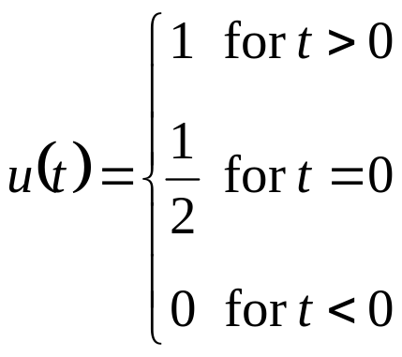
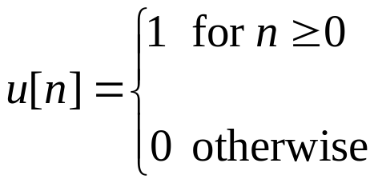
Signal Representation
A function, e.g. sin(t) in continuous-time or
sin(2 π n / 10) in discrete-time, useful in analysis
A sequence of numbers, e.g. {1,2,3,2,1} which is a sampled triangle function, useful in simulation
A collection of properties, e.g. even
symmetric about origin, useful in
reasoning about behavior
A piecewise representation, e.g.
A functional, e.g. the Dirac
delta functional δ(t)
2-<number>

Slide 3
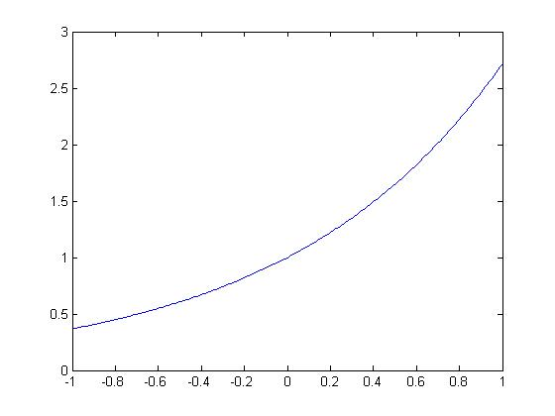
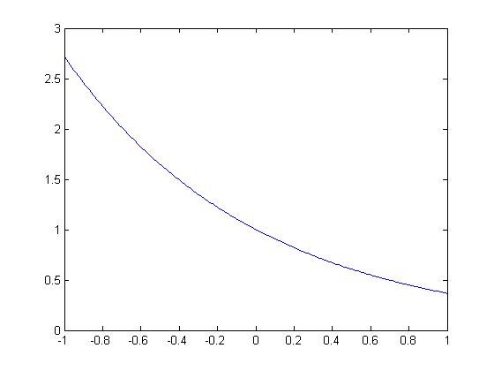
Exponential Signals
Solutions to linear constant-coefficient differential equations, and hence, very common
e^{-t}
e^{t}
t
t
t = -1 : 0.01 : 1;
e1 = exp(t);
plot(t, e1)
t = -1 : 0.01 : 1;
e2 = exp(-t);
plot(t, e2)
2-<number>

Slide 4
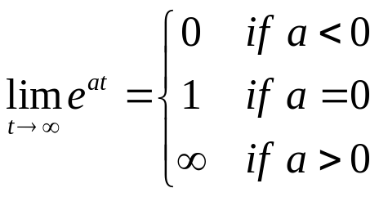




Exponential Signal Properties
Real-valued exponential signals
  Amplitude values are always non-negative
  Might decay or not as t goes to infinity
Complex-valued exponential signals
We’ll need these properties throughout the semester
2-<number>

Slide 5
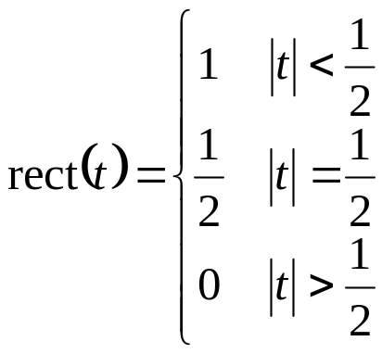
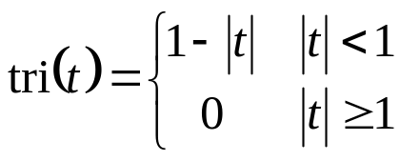
Piecewise Functions
Unit area rectangular pulse
What does rect(x / a) look like?
Unit triangle function
rect(t)
1
t
-1/2
0
1/2
Math commands
rectpuls(t)
tripuls(0.5*t)
tri(t)
1
t
-1
0
1
Both functions are even symmetric about origin.
2-<number>

Slide 6
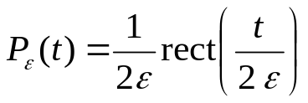


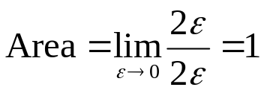
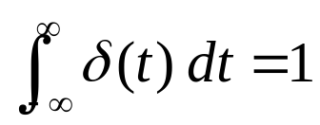
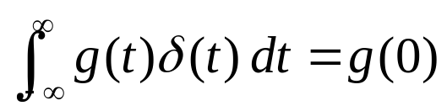
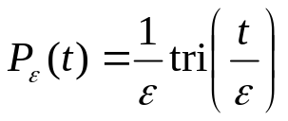

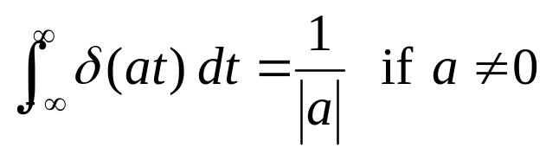
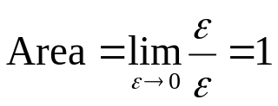
Dirac Delta Functional
Mathematical idealism for
an instantaneous event
Dirac delta as generalized
function (a.k.a. functional)
  Unit area:
  Sifting
  provided g(t) is defined at t = 0
  Scaling:
Note that δ(0) is undefined
−ε
ε
t
Unit Area
−ε
ε
t
Unit Area
2-<number>

Slide 7
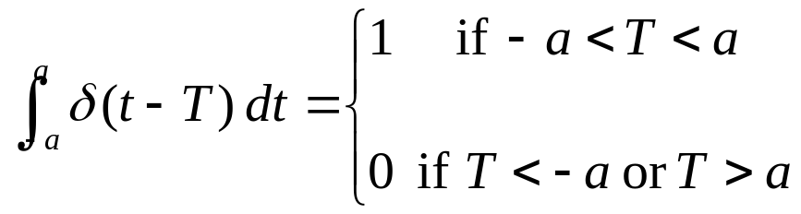

Dirac Delta Functional
Generalized sifting, assuming that a > 0
By convention, plot Dirac delta as arrow at origin
  Undefined amplitude at origin
  Denote area at origin as (area)
  Height of arrow is irrelevant
  Direction of arrow indicates sign of area
Simplify Dirac delta terms only under integration
(1)
Unit Area
0
t
2-<number>

Slide 8
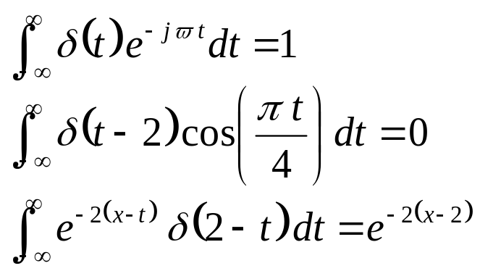
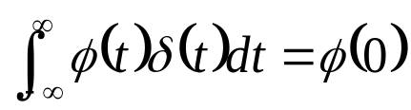
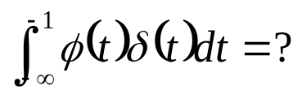
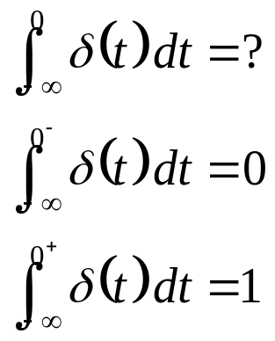
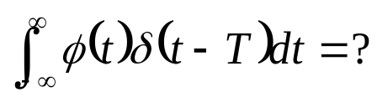
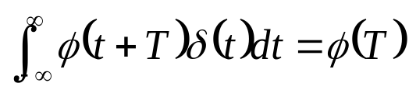
Dirac Delta Functional
We can simplify δ(t) under integration
What about?
  Answer: 0
What about?
  By substitution of variables,
Other examples
What about at origin?
Before Impulse
After Impulse
2-<number>

Slide 9
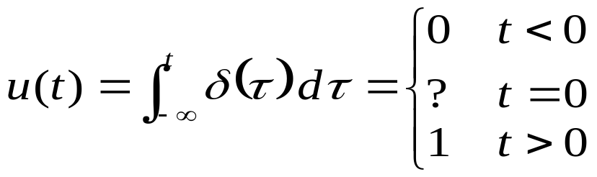
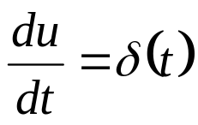
Unit Step Function
Models event that turns on and stays on
Definition
What happens at the origin for u(t)?
  u(0⁻) = 0 and u(0⁺) = 1, but u(0) can take any value
  Textbook uses u(0) = ½ to average left and right hand limits
  Impulse invariance filter design uses u(0) = ½
L. B. Jackson, “A correction to impulse invariance,” IEEE Signal Processing Letters, vol. 7, no. 10, Oct. 2000, pp. 273-275.
Math command stepfun(t,0) defines u(0) = 1
2-<number>

Slide 10
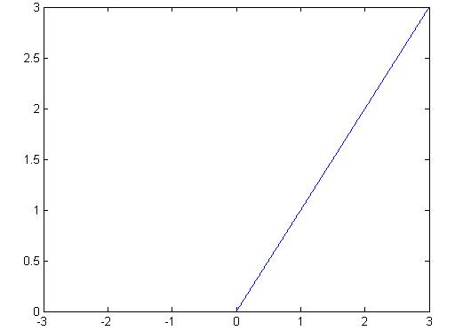
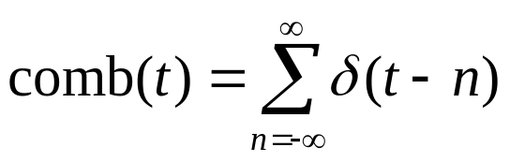

Other Important Functions
Ramp
  ramp(t) = t u(t)
Unit comb
  Impulse train
(1)
(1)
(1)
(1)
(1)
(1)
t
t
-2
-1
0
1
2
3
t = -3 : 0.01 : 3;
r = t .* stepfun(t,0);
plot(t, r)
2-<number>

Slide 11
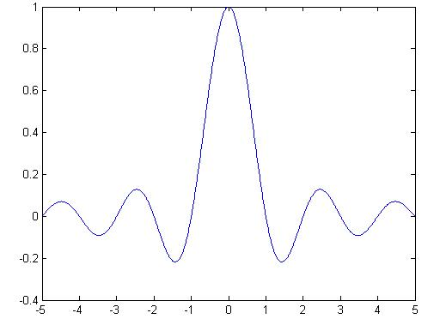
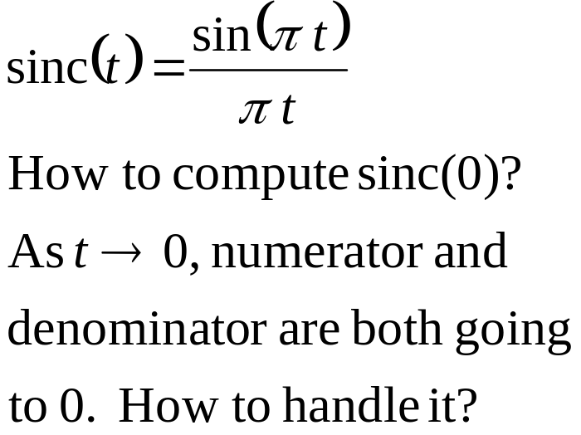

Sinc Function
t = -5 : 0.01 : 5;
s = sinc(t);
plot(t, s)
  Even symmetric about origin
  Zero crossings at
  Amplitude decreases proportionally to 1/t
2-<number>

Slide 12


Sampling
Many signals originate as continuous-time signals, e.g. voice or conventional music
Sample continuous-time signal at equally-spaced points in time to obtain discrete-time signal
  y[n] = y(n T_{s})
  n ∈ {…, -2, -1, 0, 1, 2,…}
  T_{s} is sampling period
Example
T_{s}
3
4
5
6
7
n
1
2
y(t)
2-<number>

Slide 13
Audio CD Samples at 44.1 kHz
Human hearing is from about 20 Hz to 20 kHz
Sampling theorem (covered at mid-semester): sample continuous-time signal at rate of more than twice highest frequency in signal
Analog-to-digital conversion for audio CD
  First, apply a filter to pass frequencies up to 20 kHz (called a lowpass filter) and reject high frequencies. Lowpass filter needs 10% of cutoff frequency to roll off to zero (filter can reject frequencies above 22 kHz)
  Second, sample at 44.1 kHz captures analog frequencies of up to but not including 22.05 kHz
  Third, quantize to 16 bits per sample
2-<number>

Slide 14
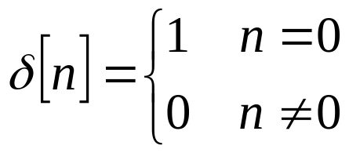
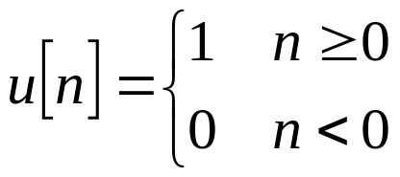
Discrete-Time Impulse and Step
Impulse function
  Also called Kronecker Delta
  Even symmetric about origin
Unit step (unit sequence)
δ[n]
1
n
-2
-1
0
1
2
3
u[n]
n = -2 : 3;
u = stepfun(n,0);
stem(n, u);
1
n
-2
-1
0
1
2
3
2-<number>

Slide 15
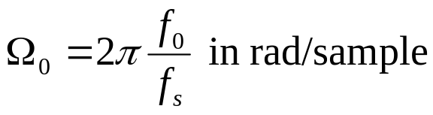
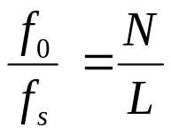
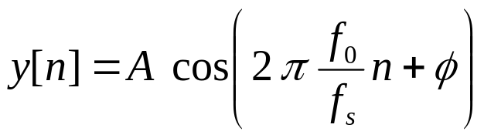
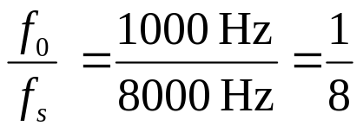
Discrete-Time Sinusoidal Signals
Sinusoidal signal in continuous time
Sample using sampling period T_{s}
Substitute T_{s} = 1 / f_{s},
f_{s} is sampling rate,
Discrete-time frequency
  Given integers N and L with common factors removed, discrete-time
  sinusoid has
  period L if
Example: singing a tone during cell phone call
2-<number>

